Slide 2


Graphic Section Divider

Slide 3
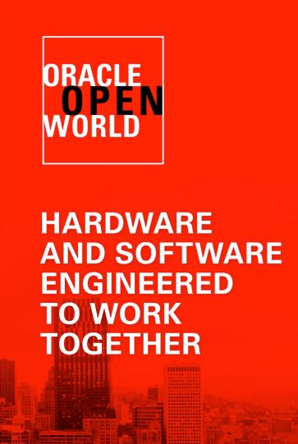
Oracle Fusion Supply Chain Management: Overview, Strategy, and Roadmap
Jon Chorley – CSO and Group Vice President
Applications Development, Oracle

Slide 4
The following is intended to outline our general product direction. It is intended for information purposes only, and may not be incorporated into any contract. It is not a commitment to deliver any material, code, or functionality, and should not be relied upon in making purchasing decisions. The development, release, and timing of any features or functionality described for Oracle’s products remains at the sole discretion of Oracle.

Slide 5
Program Agenda
Fusion SCM Applications Today
Fusion SCM Roadmap

Slide 6

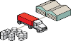



Fusion SCM Today
Five next-generation applications built on a common SCM model
Highly differentiated new modules, complementary to a broad range of existing and new (SCM-centric) customers
Supporting inventory for financial & procurement (in non SCM-centric companies for now)
Product Master Data Management
Global Order Promising
Distributed Order Orchestration
Inventory Management
Cost Management
Core SCM Model and Framework
Data Model and Services
Business Processes
Analytics and Calculations
Integration Services
Functional Setup & Admin
Data Model Extensibility

Slide 7

Fusion Distributed Order Orchestration and Global Order Promising

Slide 8









Oracle Fusion Distributed Order Orchestration
Multi-Channel Fulfillment
Orders across all channels, including partners
Web
Call Center
Stores
Partner Stores
Distributors
Mobile
Distributed Order Orchestration
Fulfill across all sources, including partners
Internal DC
3rd Party DC
Supplier
Stores
Finance
Notes:
Let’s look at some examples of how Oracle’s VCE solutions support Virtualization.
Fusion DOO is designed to help companies manage the fulfillment of customers orders across a virtualized network of multiple demand channels and fulfillment sources. The demand channels may include partner sources, such as orders sold through wholesale distributors or partner stores. Likewise, the fulfillment sources may include internal locations as well as partners (e.g., drop shipments from external contract manufacturers, shipments from warehouses managed by a 3PL).
Regardless of demand channel or fulfillment source, Fusion DOO provides a common platform to plan and orchestrate the fulfillment of these orders. New channels, sources, and fulfillment processes can be added quickly as conditions change.

Slide 9
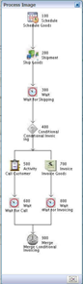
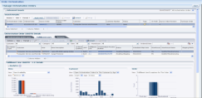
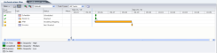
Why is Fusion DOO Better and Different?
Makes Your Existing Investments Better
Create a unified customer and user experience without the need to rip-and-replace multiple complex systems
Accelerates Your Ability to Change
Rules-based and highly configurable, you can quickly add and integrate new products & processes, new fulfillment methods & channels, new acquisitions …
It’s Real Application (not a tool-kit)
Other approaches require custom development with associated high risks, and long-term TCO issues
It’s Standards Based
Critical to the class of application

Slide 10
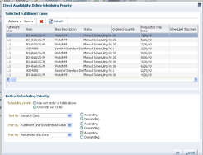
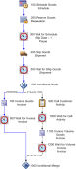
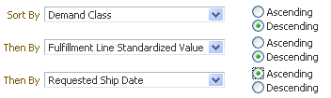
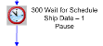
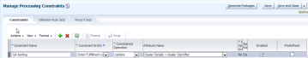
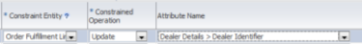

Oracle Applications: Current Release and Roadmap Distributed Order Orchestration
Improved Customer Satisfaction
Notifications & business events
Order priority scheduling & reservation
Managing pre-orders
Customer specific status/exception summaries
Customer defined shipping statuses
Faster Time to Revenue
Backlog Management
Mass scheduling
Enhanced error recovery
Lower Cost of Ownership
Time, event & or manually triggered coordination with fulfillment systems
Searching user defined fields
Configure business rules using user defined fields
Increased flexibility for cross channel order inquiry
Concurrent processing of independent order lines Coordinated fulfillment interdependent order lines
Improved Customer Satisfaction
Configured products
Installations, subscriptions, appointments
Coverage processing
Goods & services delivery coordination
Additional retail flows
Faster Time to Revenue
Integration with Fusion applications for internal orders, drop ship, back-to-back processes
Trade Management integration
Service product management with asset based ordering
Lower Cost of Ownership
Cloud enablement
Order capture integration
What’s Next
0-12 month planning cycle
Future Directions Post 12 month planning cycle
DOO Public Cloud

Slide 11
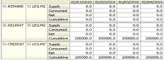
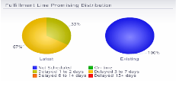
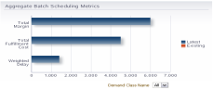
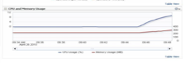
Why is Fusion GOP Better and Different?
It Includes All Sources of Supply & Demand
Unified promising across a common pool of material will deliver consistency and reduce inventory
It Supports Dynamic Simulation
Real-time re-estimating and what-if scenarios to prevent surprises
It Optimizes Both Cost and/or Service Levels
Use profit and configurable policies to control promising process
It Deals with Real-world Opportunities & Constraints
Support flexible splitting and vary allocation and promising policies for “hot” items

Slide 12
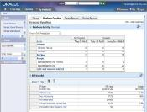
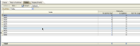
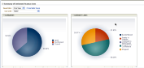
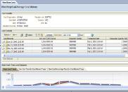
Oracle Applications: Current Release and Roadmap Cost Management
Improved Business Flow Costing
Rules-based tax determination in purchase receipt flows
Valuation of on-hand supplier consigned inventory and issues
Measurement of consignment risk exposure
Lower Cost of Ownership
Improved data defaulting for more efficient entry
Audit tools for accuracy
Streamlined and automated processes
Improved Business Flow Costing
Landed cost management
Public sector budgetary control & encumbrance accounting
Sophisticated Inter-organization transfer accounting
Support for Manufacturing
Scenario-based standard cost planning
Standard cost rollup & publication framework
Work order costing
Configured item cost planning & accounting
Enterprise product cost/profit planning & gross margin analytics
What’s Next
0-12 month planning cycle
Future Directions Post 12 month planning cycle
DOO Public Cloud

Slide 13

Distributed Order Orchestration with GOP
BENEFITS
Accurate order promising with global View of supply
Higher Service with Proactive exception Monitoring and Resolution
Faster time to revenue through Adaptable, Flexible, Consistent business processes
Strategic customer/demand Segmentation to drive fulfillment priorities
Lower cost of ownership using Declarative web based application configuration
Improve time to revenue
Reduce order processing cost
Increase order promising accuracy
Reduce inventory costs
Lower cost of implementation

Slide 14


Michelin
One of the two largest tire manufacturers in the world. In addition to the Michelin brand, it also owns the BFGoodrich, Kleber, Tigar, Riken, Kormoran and Uniroyal (in North America) tire brands.
Michelin needed to regain its global supply chain visibility, optimize its inventory, and improve its end-customer delivery commitments.
Oracle SCM:
Fusion Distributed Order Orchestration
Reduced inventory costs
Improved available to promise reliability
Enhanced visibility across the enterprise supply chain
Increased market loyalty
Challenge
Solution
Result
michelin
Notes:
Additional information for this customer can be found on the Win with Oracle Applications blog:
http://emeablogs.oraclecorp.com/oracleapps/2013/04/23/distributed-order-orchestration-drives-change-at-michelin-for-internal-use-only/

Slide 15
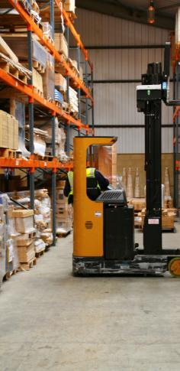
Fusion Inventory Materials and Cost Management

Slide 16
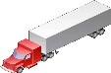
Fusion Materials Management
Receive
Inspect
Replenish
Deliver
Cost
RMAs Purchases Transfers
Cycle Count
Move
RTVs Orders Transfers
Ship
Pack
Pick
Report
Physical Inventory
Transfer
SOA-based Integration
Distributed Order Orchestration
Procurement
Financials
Product Information Management
Notes:
At the core, Fusion Materials Management covers all of the expected functionality of a materials management system from receiving, inventory management and fulfillment in a role specific manner giving each user the information they need to efficiently do their job AND uses the latest standards-based technologies to integrated with Order Management, Procurement, Financials and Product modules.

Slide 17
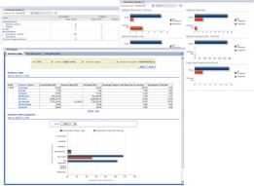
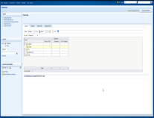
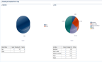
Why is Fusion Materials Management Better and Different?
Flexible deployment options
Available in the cloud and on-premise
Completely Redesigned UI and User Experience
Incorporates all of the learning's from EBS and JDE and implements this using the best in Fusion technology
Centralized Monitoring of Inventory Operations
Use of Workbenches, Analytics, and Dashboards puts the user in control
Efficient Shipping & Receiving
To ensure shipments and receipts are processed quickly and accurately in order to satisfy customer demand
Inventory Cloud Service
Notes:
1. Flexible deployment options
Fusion Inventory and Costing Cloud Service allows customers to quickly deploy Available in the cloud and on-premise
Completely Redesigned UI and User Experience
Incorporates all of the learning's from EBS and JDE and implements this using the best in Fusion technology
Centralized Monitoring of Inventory Operations
Use of Workbenches, Analytics, and Dashboards puts the user in control
Efficient Shipping & Receiving
To ensure shipments and receipts are processed quickly and accurately in order to satisfy customer demand

Slide 18
Oracle Applications: Current Release and Roadmap Fusion Materials Management
Efficient Flexible Distribution
Flexible internal material movement fulfillment options
Shipping Document Support for Supplier Returns
Decoupled Material & Financial Transactions
Financial Orchestration Support
Flexible supplier consignment
Enhanced Tax Point Support
Efficient, Flexible Distribution
Drop Ship
Back –to-Back orders
Internal and Contract Manufacturing Support
3PL/WMS Integrations
ATO Fulfillment Support
Decoupled Material & Financial Transactions
Budgetary control
Encumbrance accounting
What’s Next
0-12 month planning cycle
Future Directions Post 12 month planning cycle
Inventory Cloud Service

Slide 19
Consigned Inventory from Supplier
The Business Opportunity
Reduce working capital
Improve fill rates
Reduce inventory write-offs
The Challenge
Decoupling physical & change in ownership
Reconciliation
Negotiate Consigned Agreement
Create Consignment Order
Receive Consigned Material
Consume Material (change in ownership)
Communicate Consumption Advice
Pay supplier
The Solution
Consigned Agreement modeled as Supplier Agreement
Consumption Advice modeled as business document
Supplier collaboration includes spreadsheet download
Automated process for Return to Supplier and Return to Consignment
End-to-end traceability of entire process enables periodic reconciliation
Notes:
The opportunity – Consigning inventory from suppliers allows you only pay for only the inventory which you use.
The challenge – The consignment process adds additional complexity and overhead to the procure-to-pay process. Taking ownership of inventory needs to be decoupled from the physical receipt of inventory. And this additional change in ownership step in the procure-to-pay process needs to be reconciled, just as the receipt & billing steps get reconciled.
The solution – Fusion Consigned Inventory from Supplier solution has also been re-architected and “built-into” the procure-to-pay process instead of “bolt-onto” the traditional procure-to-pay process.
Highlights of the upcoming solution include:
When you negotiate a consigned agreement with your supplier, that is supported as a part of the standard Supplier Agreement process
In EBS, the Consumption Advice was “shoe-horned” into the process as a Blanket Release PO against the BPA. This approach led to issues in AP matching, periodic reconciliation, and automating returns.
Efficient collaboration with the supplier is critical. When companies access a portal, they want the ability to perform spreadsheet download.

Slide 20

Fusion Internal Material Transfers
Internal Material Transfers
Transfer to inventory or expense destination
Single document to manage physical flow
Supply Chain Financial Orchestration to manage financial flow
Planned, Replenished, Self-Service or Back-to-Back initiated
Optionally manage in DOO for order prioritization
Integrated shipping and receiving flows
Full change management & returns support
Notes:
Fusion Internal Material Transfers
- Separates the physical flow from the financial flow which is handled by SFO
Replaces the EBS IR/ISO process with a new single Transfer Order that is both the supply and demand document
Supports both manual transfer requests from self service users who need want to request material that is transferred to an expense destination or inventory professionals who are transferring material
Supports automate transfers from planning moves, min max inventory replenishment and back-to-back transfers
Flexibility to create rules to determine if transfers are executed via TO or via PO document based on country or company policy
TO’s can be sent directly to shipping or through Fusion DOO where the internal TO’s can be viewed with external SO’s for evaluating order prioritization
Supply side source organization changes or demand side destination organization changes are kept in sync with this single TO document
Supports both physical and accounting only returns of internal material transfers
Change management is automated between the Transfer Order and the Shipping Request in Shipping, Expected Receipt in Receiving, and Fulfillment Request in DOO (optional).

Slide 21
Oracle Applications: Current Release and Roadmap Cost Management
Improved Business Flow Costing
Rules-based tax determination in purchase receipt flows
Valuation of on-hand supplier consigned inventory and issues
Measurement of consignment risk exposure
Lower Cost of Ownership
Improved data defaulting for more efficient entry
Audit tools for accuracy
Streamlined and automated processes
Improved Business Flow Costing
Landed cost management
Public sector budgetary control & encumbrance accounting
Sophisticated Inter-organization transfer accounting
Support for Manufacturing
Scenario-based standard cost planning
Standard cost rollup & publication framework
Work order costing
Configured item cost planning & accounting
Enterprise product cost/profit planning & gross margin analytics
What’s Next
0-12 month planning cycle
Future Directions Post 12 month planning cycle
DOO Public Cloud

Slide 22



Red Robin Gourmet Burgers, Inc.
Rapidly growing casual-dining franchise with over 450 restaurants in the U.S. and Canada.
Live
Red Robin outgrew its aging, customized infra-structure and needed a flexible architecture to accommodate future business model changes and growth.
Oracle Hosted ERP, HCM, & SCM:
Oracle Financials
Oracle Procurement
Oracle Project Portfolio Management
Oracle Global HR
Oracle Talent Mgmt
Oracle Value Chain Execution
Lowered labor and food costs
Improved recruiting of candidates
Improved service for guests at hundreds of Red Robin locations
Challenge
Solution
Result
Notes:
Solution Footprint:
Oracle Financials–
Fusion Automated Invoice Processing
Fusion Financial Reports Center
Fusion Financials
Fusion Transactional Business Intelligence for Financials
Oracle Procurement–
Fusion Transactional Business Intelligence for Procurement
Fusion Procurement Contracts
Fusion Self Service Procurement
Fusion Purchasing
Fusion Sourcing
Fusion Supplier Portal
Oracle Project Portfolio Management–
Fusion Project Control
Fusion Project Costing
Fusion Transactional Business Intelligence for Projects
Oracle Global HR–
Fusion HCM Base
Fusion Benefits
Fusion Global Payroll
Fusion HR Analytics
Fusion Workforce Compensation
Fusion Workforce Directory Management
Fusion Workforce Lifecycle Management
Fusion Workforce Predictions
Fusion Transactional Business Intelligence
Oracle Talent Mgmt -
Fusion Goal Management
Fusion Talent Review
Fusion Performance Management
Oracle Value Chain Execution–
Fusion Distributed Order Orchestration
Fusion Supply Chain Business Intelligence
Additional information for this customer can be found on the Win with Oracle Applications blog:
http://emeablogs.oraclecorp.com/oracleapps/2012/03/01/fusion_flavored_burger_anyone/
This customer was featured in external reference asset s:
Video Montage
Herbalife, Red Robin, Lending Club, and Cricket Communications (Taleo)
Oracle ERP and HCM Clouds Drive Businesses Forward
http://medianetwork.oracle.com/video/player/1922133978001
Video
Red Robin Transforms Business with Oracle’s Cloud Solutions
http://medianetwork.oracle.com/video/player/2011623703001
Competitor: Workday
Reason for Win: Complete, Integrated ERP and HCM solution
Partner: Cognizant
Region: North America
Deployment: On Demand

Slide 23

Fusion Product Master Data Management

Slide 24






Solving the Commercialization Problem
Stores
Enrich Product and Catalog Information in a Central Location
Orchestrated Collaborative Product Definition
Governance and Approval Workflow
Dynamic Rule-Based Policy Enforcement
Local Languages
Local Units of Measure
Local Currencies
Print Catalog
Provide localizations for multiple geographies
Complete Product Information
Web
Approve new products and services
Assign products to different catalogs
Define product specifications
1
2
3
4
Call Center
Fusion Product Hub
Extensible and Scalable Data Model
Product Attributes, Rich Formatted Descriptions, Relationships and Pack Configurations
Real-Time/Embedded Data Cleansing and Standardization
Digital Asset and Unstructured Data Association
Role Based and Data Level Security
Supplier Catalog
UNSPSC Catalog
Merchandising Catalog
Web Catalog
Print Catalog
Kiosk
Mobile

Slide 25










Solving the Order and Fulfillment Challenge
Establish Master Enterprise Product Record and Centralize Order Orchestration and Fulfillment
Order Capture
Store
Web
Call Center
Kiosk
Mobile
Commercial Catalogs
(Merchandise, Web,…)
Product Specifications (Rich Formatted Descriptions, Images,…)
Up-Sell/Cross-Sell Items
Orders, Changes, Cancellations, Status
Decomposition
Orchestration
Global Order Promising
Fusion Product Hub
(Complete Enterprise Product Record)
Distributed Order Orchestration
(Centralized Order Orchestration and Fulfillment)
Item Supplier/Location Associations
Source Selection, Splitting, Monitoring/Updates
BOM and Pack Configurations
Fulfillment
Operational Attributes (Inventory, Planning, Distribution,…)
Warehouse
Logistics
Store
Suppliers
Finance

Slide 26
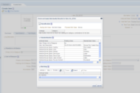
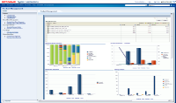
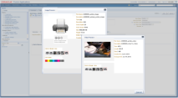
Why is Fusion Product MDM Better & Different?
Modern. Purpose Built. SaaS Enabled. Standards Based.
Completely Redesigned UI and User Experience
Incorporates all of the learning's from EBS PIM and implements this using the best in Fusion technology
Integrated Data Quality to Improve Data Accuracy
Ability to enforce data quality standards and enforcement as the data in real-time and in batch
Centralized Governance Enforces Data Policies
Configurable processes for approvals and version management, combined with analytics to assess quality and compliance
Extensible Data Model
Add additional data elements and validation for different requirements, all without programming
Product Hub Cloud Service

Slide 27

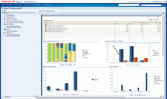

Oracle Applications: Current Release and Roadmap Fusion Product Hub
Efficient Multi-Channel Commerce and Customer Experience
Self Service Data On-boarding via Product Portal (Vendors/3rd Party)
GDSN infrastructure for on-boarding supplier data via GS1 data pools
Bulk upload and association of digital assets
Carousel View and Thumbnail Visualization for Multiple Images
Integration to Oracle Commerce and RMS
Data Governance and Standards Enforcement
Matching by Manufacturer Part Numbers
Matching by GTINs
Pre-import validation and Audit Trail
Faster Deployment and Lower Total Cost of Ownership
Rich and Secure Cloud based Web Services
Product Hub Portal for Vendor Product Upload
Superior User Experience
Visual batch summary
Dedicated batch error management UI
Item/Web Preview
CO/NIR Usability Enhancements
Efficient Multi-Channel Commerce and Customer Experience
Vendor Data Upload/Quality Scoring and Metrics
Supplier Collaboration and Social Interaction
Digital Asset Meta data Search and Embedded Workflow
Advanced Catalog Management
Desktop Publishing Templates and Style Tags
Extensible Business Context for Product Data
Data Quality & Data Governance
Individual Object History/Audit Report
Change Definition Steps/
Mobile based Change/NIR Review and Approval
Embedded Completeness & Conformity Metrics
Enhanced BI Reports
Cloud Enablement
Cloud Service Expansion
Superior User Experience
Optimized UI for Multi-Lingual Data Maintenance
Product Data Relationship Viewer
What’s Next
0-12 month planning cycle
Future Directions Post 12 month planning cycle
Now
Rapid Time to Market
Orchestrated Collaborative Product Definition
Extensible and Scalable Enterprise Product Record
Harmonized Product Data across and beyond the Enterprise
Consolidate, Standardize and Cross Reference data from multiple sources
Publish Accurate and Consistent product data to Consuming Systems
Data Quality & Governance Policy Enforcement
Real-Time/Embedded Data Cleansing, Classification and Standardization
Dynamic Rule-Based Policy Enforcement and What-If Analysis
Granular Version Management
Role based and Data Level Security

Slide 28
Value Chain Transformation
ROI
BENEFITS
Accelerate product commercialization and launch
Enable Product Data Quality Standards
Enforce Governance policies for compliance
Orchestrate and Collaborate on single Product definition
Ensure Product Compliance
Consistently Harmonize product Data across and beyond the Enterprise
Share Clean and Accurate Data with Trading Partners
Greater Agility to respond to data Changes
Improved Change Approval and Cycle Time
Accelerated Time to Market
Elimination of Duplicate and Redundant Product Information
Reduction in Downstream Errors(Inventory Stock Outs, Order/Invoice Errors)
Lower Part Returns on missing information

Slide 29


O’Reilly Media
Media company based in California with 270 employees globally that spreads the knowledge of innovators through its books, online services, magazines, research, and conferences.
Live
O’Reilly Media needed to replace its costly and restrictive customized product master data solution. It wanted an IT enabler to help it remain relevant in a rapidly changing industry.
Oracle SCM Cloud:
Fusion Product Hub
Improved product time to market
Provided a scalable IT Infrastructure to support corporate growth
Increased efficiency resulting from streamlined workflow
Challenge
Solution
Result
Notes:
Additional information for this customer can be found on the Leading with Oracle Applications blog:
http://emeablogs.oraclecorp.com/oracleapps/2013/01/02/fusion-product-hub-cloud-service-fusion-scm-win-at-oreilly-media-for-internal-use-only/

Slide 30

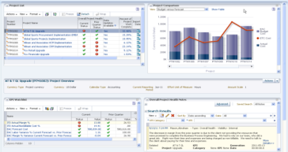
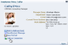
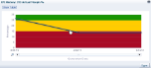
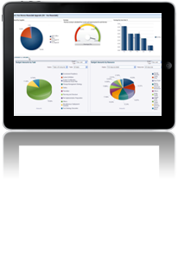

Oracle ERP Cloud Service
Procurement
Purchasing Self Service Procurement Sourcing Procurement Contracts Supplier Portal
Financial
Management
Financials
Expenses
Financial Reports Center
Risk & Control Mgmt
Planning & Budgeting
ERP
Project
Portfolio Management
Project Budgeting & Forecasting
Project Costing
Project Contracts & Billing
Project Performance Reporting
Supply Chain Management
Inventory & Cost Mgmt
Shipping & Receiving
Product Data Master
Supply Chain Performance Reporting
Copyright © 2012, Oracle and/or its affiliates. All rights reserved.
Notes:
Simplify
Your business processes and technology requirements
Accelerate
Your return on investment
Collaborate
With stakeholders within and outside your company
Control
Your costs with increased productivity and policy enforcement
Integration
Cloud Connect – web services, spreadsheet/file based
Configuration
Preconfigured templates and spreadsheet wizards for complex setups like enterprise structures
Extensibility
Page, Process, Report Composers

Slide 31
Program Agenda
Fusion SCM Applications Today
Fusion SCM Roadmap

Slide 32
What’s Next & Future Innovation Management, Configurator, Pricing

Slide 33
`
Notes:
Slide Transition: (note: We have five seconds to grab the viewers attention and only minutes to keep it)
Can we add some compelling provacation: Start with a strong affirmation that surprises or shocks the audience.
If there’s one word companies aspire to be, it would be innovative. Some people get caught up in the definition of innovation, whether it’s the disruptive kind that transforms what exists or creates what doesn’t, or the incremental kind that comes from one small improvement building upon another.
For purposes of our discussion, the point is this: every company wants to be more innovative.

Slide 34


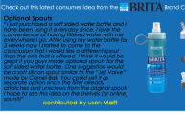



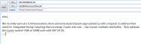
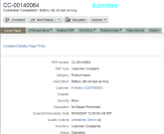
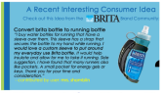

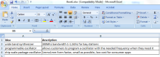
Starting Point: Many Sources of Ideas – ... where to invest to maximize return on product development?
Thousands of Transactional Records
…difficult to identify the most important opportunities, investments
…scattered input from key functional teams
Available resources quickly over loaded …
New idea

Slide 35
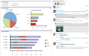
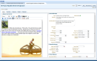
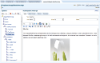
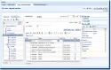

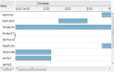
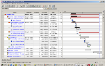
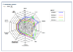


Oracle Fusion Innovation Management
Closing the loop between Strategy and Product Development Execution
IDEA
Approval
Launch
IN-MARKET
PRODUCTS
End of Life
Idea
Screen
CAPTURE & PRIORITIZE IDEAS
INITIATE
PRODUCT
PROPOSALS
DEFINE
REQUIREMENTS
DEVELOP
CONCEPT
OPTIMIZE
INVESTMENT
PORTFOLIO
PRODUCT
DEVELOPMENT
EXECUTION
Notes:
Slide 12 – Should build this slide. Too much content without building
Hitachi Tag line: Innovation is translation of ideas and inventions into profitable offerings for customers.

Slide 36
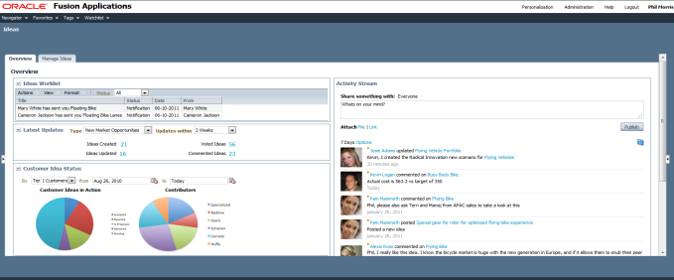
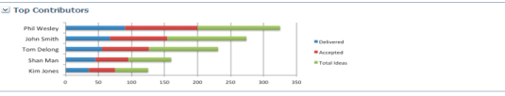
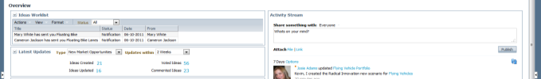
Accelerating Your Innovation Stream with Fusion Innovation Management
“I need to see more details”
“What’s happening in my Innovation Social Network?”
“What new ideas are there?”
“Show me status by Customer”
“Which customers are contributing?”
“Where are the good ideas coming from?”
Notes:
Idea management –
Take in the voice of the customer and evaluate with your team – allows voting, crowd sourcing, etc.
Collaborate on ideas in social network, helping you to refine the ideas

Slide 37
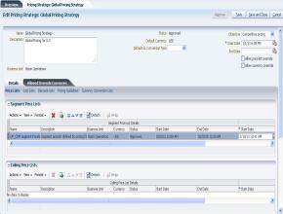
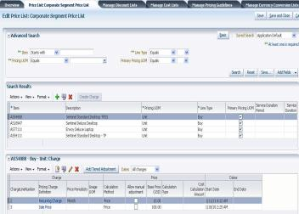
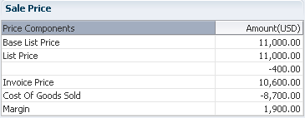
Fusion Pricing
Improve Margins with Better Price Performance
Completely Redesigned Pricing Architecture
Best in Fusion technology on the Cloud
Price Breakdown & Guidelines prevent Margin Leakage
Avoid margin leakage through price waterfall analysis and guidelines to enforce compliance and prevent improper discounting
Configurable Pricing Engine tailored to Business Process
Allows you to configure your pricing process to the needs of your business and quickly respond to changing market conditions
Pricing Strategies for Targeted Pricing and Segmentation
Pushes corporate pricing strategy to the front line sales rep allowing you to deliver optimal prices according to buying characteristics of the customer
Define Global Pricing Strategy with
local optimization
Manage all types of Pricing Rules in a Centralized Workbench
Pricing Guidelines to enforce compliance
Share
Price Breakdown Analysis for Quote / Order
Model all types of prices – usage, recurring etc.

Slide 38



Fusion Configurator
Match Customer Requirements to the Best Possible Solution
New Dynamically Generated Runtime UI
Available anywhere, anytime on any device
Completely Redesigned UI and User Experience
Improves the experience of creating and maintaining Configurator models
Integrated Workspace provides the ability to collect model changes, test, and release to production
Incorporates WYSIWYG UI Editing
Presents the Runtime UI in edit mode to facilitate rapid UI development
Powered by Advanced Constraint Technology
Oracle’s own ACT product is the engine powering the logic for each Configurator model
Notes:
Integrate Configurator Across the Enterprise
Configure Products to Unique Customer Requirements
Simplify Configuration of Complex Solutions
Centrally Create and Manage Configurator Models

Slide 39

What’s Future Value Chain Planning

Slide 40




Fusion Planning Central
A unified demand and supply planning foundation
Guided navigation
Embedded Business Intelligence
Simplified demand forecasting
Flexible safety stock calculation
Unconstrained supply planning
Cloud or on-premise deployment

Slide 41


Unified Demand and Supply Planning Example
Demand-Supply Balancing
“What can I do now to fulfill at-risk demands?”
“Which at-risk demands have the largest Rev impact?”
Notes:
Unified demand and supply planning give you a role based approach to planning.
Unified UI, exceptions management and measures means that planners can easily move between subject areas and access the information that they need for their role at your company.
And to help make decision making simpler, we are embedding innovative analytics, such as this heat map, that helps you easily understand what the problems are and which have the most impact to your business.
The system then gives you options and guidance for how to resolve the issues. You can compare multiple options and see the impact they have on revenue or other key performance indicators. Once you choose the one that best fits your business goals, the systems tells you what to do next to implement the decision.

Slide 42



Fusion Sales and Operations Planning
Real-time strategic planning scenarios
“What are issues, assumptions, and proposal for executive review?
“Can I make strategic decisions in the meeting?
“What is my S&OP process calendar & groups?
Notes:
Fusion S&OP is the first step toward our vision to provide a comprehensive, role-based value chain planning solution
- built on the latest technology
- using a common framework for exceptions, measures and visualization of your supply network
- with embedded analytics to make complex decision making simple (by providing you with the information you need, when you need it in a visual manner).
Fusion S&OP is designed to be used both in preparation for and during your S&OP meetings to provide you with the tools you need for…
Collaboration
You define the participants in the process, add them to the group and use our collaboration tools to share calendars & documents, participate in conversations, and keep track of unstructured feedback that comes during executive reviews. (things like issues and action items)
Real Time strategic decision making
Fusion S&OP gives you the tools to do your traditional Demand, Supply and Budget Balancing + gives you enhanced ability to make strategic decisions during your S&OP meetings, with real-time aggregated adjustments. You can, for example, change the resource allocation at a PF level, or change your bills of distribution and see how it impacts your plans, in real-time.

Slide 43

What’s Next & Future Orchestration

Slide 44
Three Inter-related Orchestration Solutions
Distributed Order Orchestration
Supply Chain Orchestration
Supply Chain Financial Orchestration
Customer Shipments
External Drop Shipments
Coordination of Goods and Services
Internal Orders
Configured Orders
Back to Back Orders
Outsourced Mfg Orders
Internal Drop Shipments
Tax Efficient Revenue Recognition
Notes:
Three complementary orchestration solutions
DOO:
Jon already talked about – is available today, and focus on the end customer fulfillment.
Focuses on end customer shipments (including drop shipments from suppliers), and coordination of services with those product shipments.
SCO:
Is about managing supply. It gives you more control and visibility over inter-related supply documents, especially in build to order or configure to order scenarios.
SFO:
Is about managing the financial aspects of your physical movements. It manages all the financial documentation and accounting you need to support both internal and external drop shipments in your tax efficient supply chain.

Slide 45

Supply Chain Financial Orchestration Directions
Separating the Physical Movement from the Financial Ownership
Support complex, global corporate structures without compromising supply chain efficiency
Single movement of goods triggers multiple internal financial transactions, all fully documented and auditable according to local requirements
Physical Movement
Shipment, Receipt
Financial Ownership
Orders, Invoices, Payments
Notes:
SFO is about supporting your complex, global structures without compromising supply chain efficiency. It separates the physical from the financial, and allows you to model and execute both independently of each other.
Walk through example:
Shipment from China to US
But Asian HQ in Singapore requires all sales and purchases to go through Singapore
So I have two ownership transfers, China-Singapore, Singapore-China
Essentially an internal drop shipment.
Need orders, invoices, payments to back up the sale
Need to make sure they are in accordance with the transfer pricing and other agreements you have in place the the governments in the jurisdictions where you are operating.
Need a system that can
Model those agreements
Automate execution

Slide 46








Supply Chain Orchestration Directions
Managing Composite Supply
STORE INVENTORY
“Who owns the components supplied to the manufacturer”
“What alternate sources will mitigate my supply disruption?”
INTRANSIT INVENTORY
3PL NETWORK
CONSIGNED INVENTORY
DROP SHIP NETWORK
“How does the order need to be presented to the supplier?”
“What supply is in jeopardy?”
INTERNAL WAREHOUSES
INTERNAL PRODUCTION
CONTRACT MANUFACTURING
Notes:
Planning products to a great job at long range planning and high-volume build or buy to stock planning. But sometimes you need more visibility and more detailed level control.
SCO gives you the ability to decide what type of documentation and notifications to create initiate a product movement, gives you alerts when something is in jeopardy of being late, and visibility into the status of the supply and alternate supply sources that could be used.
This is critical for highly dependant, configured or built to order products, as well as other situations where you have distributed but dependant execution steps…

Slide 47
Fusion Orchestrated Fulfillment Directions
Drop Shipments / Back to Back Orders / Configured Product Fulfillment
Drop Ship PO
Vendor Shipment direct to Customer
Customer Order
Work Order
Customer Shipment
PO
Vendor Shipment
Customer Shipment
Internal Material Transfer
Internal Shipment
Customer Shipment
Configured or Standard Products
Planned & Promised
Executed & Changed Real Time
Notes:
This allows you to plan in advance, or build directly to customer order. Most commonly used for configured products, but standard products are also supported.
All of our orchestrated flows can be planned in advanced, and promised via GOP.
Once promised, our orchestration engine picks it up and automatically creates and reserves the supply to the customer order line. Any changes to supply or demand are automatically synchronized.
For configured products: details are passed onto the supplier via the purchase order details, to manufacturing via a configured work definition/job.

Slide 48
What’s Future Fusion Execution

Slide 49
Fusion Manufacturing Directions
Executive Summary
Initial Release Target
Basic Discrete Manufacturing and Kitting
Cloud or On Premise Deployment
Design Goals
Consumer App ease of use and simplicity
Optimized for mobile tablet on the shop floor
Rapid deployment with minimal configuration

Slide 50
Fusion Manufacturing Proposed V1 Scope
Cloud-based Discrete Manufacturing ERP Solution for the Mid-Market
Manage Mfg Master Data
Work Areas, Work Centers, Resources
Work Definition
Manage Production
Create jobs
View Job History
Execute Production
Perform Order-less Completion
Cost Production
Plant Calendars
Transact Jobs
Cost Planning with Roll-up
Cost execution for std, average & actual cost
Generate Parts List
View Dispatch List
Notes:
Not an immediate replacement for most EBS customers
Initial Target Goal (ultimate goal EBS parity)
Basic Discrete Manufacturing and Kitting
Mid Market
1 to a few plants
Cloud
Consumer App Ease of Use
Short time to Value – the 12-12-12 Challenge
First release prioritizes innovative solutions for 80% discrete use case - Go wide rather than deep initially
Scope driven by focus on net new customer business

Slide 51
What’s Future Product Value Chain

Slide 52






Rapid NPI with Fusion Design and Launch Management
Innovative.Visual.Social
“I need to get feedback on my designs”
“I need to actionable insight for my product design”
“I want to know the impact of my design change”
“What are all the relationships to my product”
“I need quickly approve Design Change escalations”

Slide 53






Rapid NPI with Fusion Design and Launch Management
Innovative.Visual.Social
“I need quickly approve Design Change escalations”
Overview
BOM
Changes
Team
P
Pending Changes (5)
Design Engineers
FLB1000 (Prelim) – Design A Revolution in Transportation: A Flying Bike
ECO050 (Prelim) Design Change for FLB1000
A
R
Item Class Flying Bike
UOM Each Reuse Factor .8
Make/Buy Make
New Component H12 added Approved MPN: SX39i33 Attribute Change: Weight – 30 lbs 28 lbs
C1
C2
“I need to get feedback on my designs”
MCO100 (REV B) AML Changes for HVC1000
A
R
C1a
C1b
C2a
C2b
Overview
STP2000 (REV A) Stop Ship for YK1000
A
R
Technical Specifications
Cost Information
“What are all the relationships to my product”
“I need to actionable insight for my product design”
“I want to know the impact of my design change”

Slide 54
Oracle Applications: Current Release and Roadmap Oracle Supply Chain Management Cloud
Value Chain Execution, Product Value Chain
Tech Stack Uptake
Customer Enhancements
Product Value Chain
Product Hub Publications Framework
Product Hub Portal
Demand Side GDSN Framework
Bulk Upload and Association of Digital Assets
Visualization for Multiple Images
Matching by Manufacturer Part Numbers and GTINs
Cloud Enabled Web Services
Dedicated Batch Error Management UI
Product Value Chain
Product Hub Portal Notifications
Multi Lingual Data Maintenance
PIM Audit Trail Framework Uptake
Data Governance Enhancements
PLM Innovation Management Cloud Service – New
Value Chain Execution
Product Configurator - New
Supplier Consigned Inventory
Financial Tax Points (inbound)
SFO for Intercompany - New
Procurement
Encumbrance Accounting and Commitment Control Phase 1
Product Value Chain
Product Development - New
PIM Multi Channel Retail Enhancements
Manufacturing-Related Integrations
Value Chain Planning
Planning Central - New
Enterprise Integration to Quote & Order Capture
Manufacturing-Related Integrations
Value Chain Execution
Pricing - New
Complex Distribution Flows
Enterprise Integration to Quote & Order Capture - New
Manufacturing-Related Integrations
Manufacturing
Discrete Manufacturing - New
Production Costing & mMDM - New
Asset Lifecycle Management
Asset Installed Base - New
Enterprise Integration to Quote & Order Capture
Procurement
Encumbrance & Commit Control 2
Manufacturing-Related Integrations
Release 7
Q3 2013
Release 8
Release 9/10
Future Directions Post 12 month planning cycle
Notes:
IM = Innovation Management

Slide 55
The Choice is Yours…
Continue on Your Current Path
Distributed Order Orchestration
Product Hub
Adopt a Co-Existence Strategy
Innovation Management
Embrace the Complete Suite
Quoting, Pricing & Configurator
Notes:
- Upgrade to the latest release of your current Oracle Applications
- Add new Fusion Applications modules or pillars to your current Oracle Applications
Examples within SCM are…DOO, Product Data Hub, Innovation Management, Quoting, Pricing and Configurator. Also S&OP, SFO, etc…
- Deploy the comprehensive suite of Fusion Applications products

Slide 56
Maximize Your OpenWorld SCM Experience
Conference Highlights
8 major tracks
Value Chain Planning - Product Value Chain - ALM - Procurement
Value Chain Execution - Manufacturing - Fusion SCM - Sustainability
75⁺ sessions,
≈ 200 speakers, including 80⁺ customer & partner speakers
20 demo pods
5 “Hands-On” Labs
“Meet the Experts”: All Supply Chain experts in one room!
See Focus On Documents for more information: www.oracle.com/openworld

Slide 57



Value Chain Planning Reception
Meet Value Chain Planning Customer Executives, Industry Analysts & Experts from Product Strategy, Development & Solutions in an Informative & Informal Environment
When: Monday, Sept. 23, 2013
Time: 6pm – 9pm
Where: Bluestem Brasserie - 1 Yerba Buena Lane (one block from Moscone – across Mission St.)
RSVP: http://www.oraclepartnerevent.com/2013/oow-vcp-reception/email.html

Slide 58










ALM / eAM / Manufacturing Reception
Enjoy an Evening of Networking with Friends, Partners and Fellow eAM & MFG Professionals!
When: Monday, Sept. 23, 2013
Time: 6pm – 8pm
Where: LuLu’s - 816 Folsom Street, San Francisco

Slide 59




Warehouse Management Reception
Join Oracle's Development and Strategy Team, Partners & Fellow Customers for an Evening of Mingling, Networking and Casual Conversation
When: Monday, Sept. 23, 2013
Time: 6pm – 8pm
Where: 54 Mint Restaurant - 16 Mint Plaza, between 5th St & 6th St.
RSVP: OOW13@MOD43.COM

Slide 60

Meet the Supply Chain Management Experts
Your Best Opportunity at OOW for Informal, Face-to-Face Discussions with Oracle SCM Strategy & Development Leaders
Tuesday, Sept. 24
10:30am – 11:30am
Moscone West, Room 2001A
Get answers to your business & technology questions directly from the experts in Oracle SCM Strategy & Development: PLM, Planning, Manufacturing, Maintenance, Logistics & Inventory
Walk away armed with the knowledge to secure your SCM roadmap

Slide 61




Supply Chain Management Reception
Mix & Mingle with All of Your Supply Chain Friends & Colleagues at this Uniquely San Francisco Environment Just Blocks from Moscone Center
When: Tuesday, Sept. 24, 2013
Time: 6pm – 9pm
Where: John Colins Cocktails - 138 Minna St. @ New Montgomery St
RSVP: www.oracle.com/goto/SCMreception

Slide 62

Eco-Enterprise Innovation Awards and the Business Case for Sustainability
Learn Best Practices From Oracle’s Award-Winning Customers
Oracle Speakers Include:
Jeff Henley, Chairman of the Board
Jon Chorley, Chief Sustainability Officer/Group VP
Ron Melanson, Vice President Hardware Development
Session Details – Wednesday Sept. 25th at 10:15 am Moscone West Room 2003
Notes:
Encourage your customers to attend this session where customers and Oracle sustainability experts will discuss green best practices. Hear how customers are using Oracle products to reduce both their environmental footprint as well as their costs.
The following Oracle products will be discussed in this session:
Applications: Asset Lifecycle Management , CRM OnDemand, Fleet Management, Reverse Logistics, Self-Service Applications, Transportation Management
IT Infrastructure: Database, Data Integrator, Enterprise Manager, Exadata, Exalogic, Exalytics, Fusion Middleware suite, RightNow CX Cloud Service, Servers and Storage, SPARC Super Cluster, Sun Rays,
VM, WebCenter Suite, ZFS Storage Appliance

Slide 63

2nd Oracle Value Chain Summit
Empowering the Modern Value Chain
Explore How New Solutions Within Social, Mobile, Analytics & the Cloud are Helping Companies Transform Supply Chains into Modern Value Chains
February 3-5, 2014 – San Jose Convention Center
Hands-on workshops, solutions demonstrations & more than 200 sessions on topics in 6 complementary solution areas: PLM, Manufacturing, Enterprise Asset Management, Logistics, Planning & Procurement
Early bird registration opens soon – www.oracle.com/goto/VCS14

Slide 64
Graphic Section Divider

Slide 67
声明：
所有的版权属于原有公司，文件均来自公开渠道
此文件仅供学习使用，任何人不得进行以此为商业目的的行为
如有疑问，请立即删除
学习世界五百强和咨询公司PPT课程请访问如下网站搜索：“司马懿”
百度传课：司马懿PPT学校
https://www.chuanke.com
网易学堂：司马懿PPT学校
https://study.163.com
知乎： 司马懿PPT学校
https://www.zhiu.com

